Slide 1
CALORIE CHORINICLE
Team Members:
Preetham [CSD] (21311A6717)
Viveksai [CSD] (21311A6718)

Slide 2


Contents
Absract
Introduction
Calorie counter – FRONTEND
Calorie counter- BACKEND
Procedure
DataFlow Representation
Code Implementation
Outputs

Slide 3

Technologies used
Html, CSS
Javascript
MYSQL,PHP
HTML(Hypertext Markup Language) is used to structure the content of a webpage , while CSS(Cascading Style Sheet) s employed to control to presentation and layout.
JavaScript(Js) is a versatile programming language commonly used in web development to add interactivity , dynamic behaviour, and manipulate the content of a webpage.
PHP is a server-side scripting language, and MySQL is a relational database management system. They are commonly used together in web development to create dynamic , database-driven websites. PHP process data, and MySQL stores and manages the data

Slide 4
Abstract
This web technology project employs HTML, CSS, JavaScript, PHP, and MySQL to create a comprehensive platform focused on health and nutrition. Users begin by inputting their height and weight, triggering a personalized calculation of their daily caloric requirements. The system utilizes PHP and MySQL to securely store and manage user data, ensuring accurate and confidential processing.
Furthermore, users can log their daily food items, providing a detailed breakdown of their nutritional intake. The application employs JavaScript to dynamically update and display the total calories consumed, fostering user awareness of their dietary habits. This integrated approach not only facilitates efficient data entry and processing but also enhances the overall user experience.
The project showcases the synergy between front-end and back-end technologies, delivering a seamless and interactive solution for individuals to monitor and manage their daily caloric intake. This user-centric platform promotes informed decision-making, aiding users in achieving and maintaining a balanced and healthy lifestyle.

Slide 5



Introduction:
It is a web technology project that harnesses the synergy of HTML, CSS, JavaScript, PHP, and MySQL to address a fundamental aspect of our lives—health and nutrition. This innovative platform allows users to input their height and weight, generating personalized daily caloric requirements. Leveraging the dynamic capabilities of JavaScript, users can log their daily food consumption and witness real-time updates on their total caloric intake. Behind the scenes, PHP and MySQL collaborate to securely process and store user data, ensuring a seamless and confidential user experience. This project not only simplifies calculations but also empowers individuals to make informed decisions about their dietary habits, contributing to a healthier lifestyle. Join me as we explore the intricate collaboration of front-end and back-end technologies that makes this project a promising leap forward in web development.

Slide 6
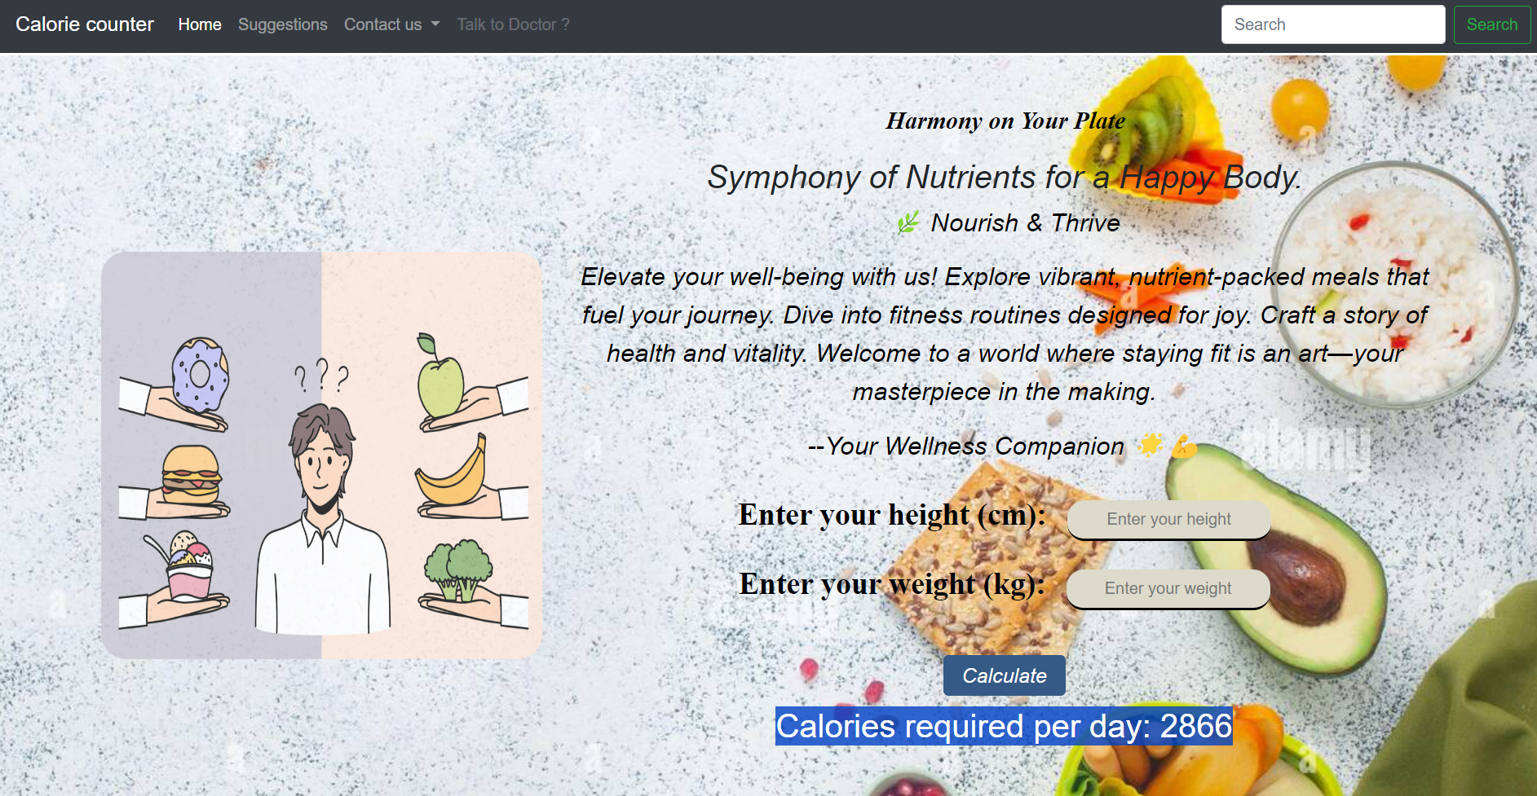
Input of Height and Weight
Users input their height and weight to determine their personalized and healthy daily calorie intake.

Slide 7
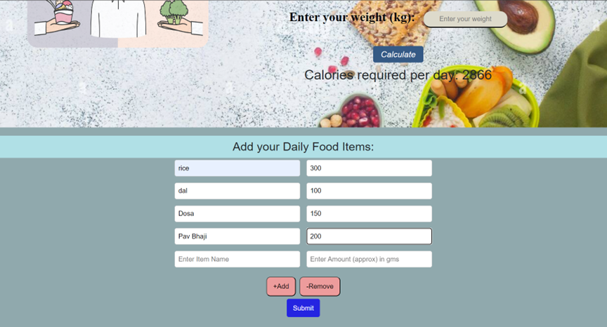
Food Calories Intake Tracking
Our food intake tracking system
allows user to input their daily
consumption rate of each food
item and retrives the calories for
each food item and calculates the
daily calorie intake will be
displayed and they can change
their meal course accordingly.

Slide 8

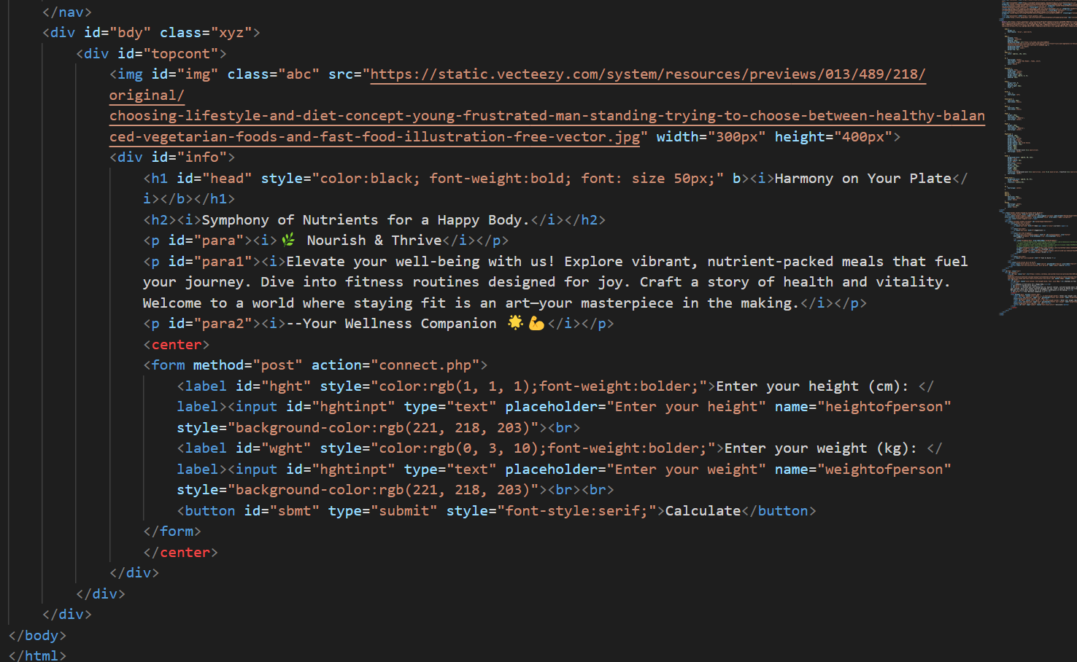
Users effortlessly input data like height and daily food, triggering dynamic PHP calculations that output personalized information, enhancing their understanding of nutritional patterns.

Slide 9
Outputs

Slide 10

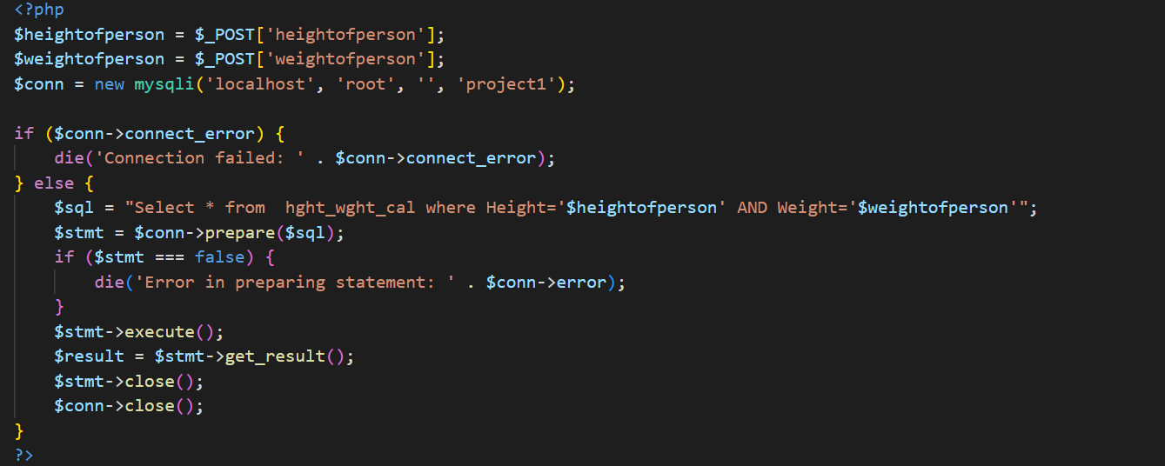
“Connecting front end to MySQL DataBase "
In this process, HTML is used to capture user input, which is then sent to a PHP script. This PHP script interacts with the MySQL database, performing actions like data retrieval or insertion. Finally, PHP dynamically generates HTML content to present the database-driven information back to the user, creating a cohesive and interactive web experience.
“I have been impressed by the quality, attention to detail and creative approach brought to every project made”

Slide 11
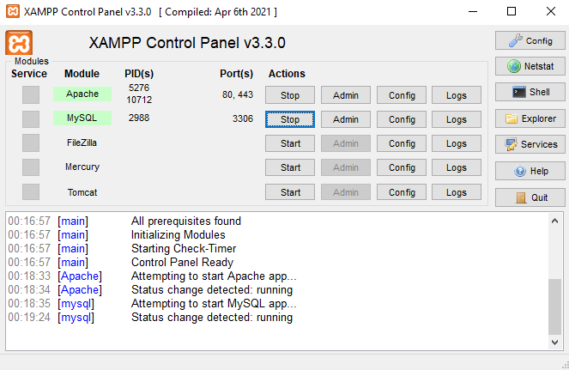
What is XAMPP ?
XAMPP is a open source provides a convenient environment by integrating essential components such as Apache web server, MySQL database, PHP scripting language and Perl programming. XAMPP simplifies the setup process, enabling developers to create a local server on their machines for efficient coding, debugging, and testing of web projects.

Slide 12
How XAMPP works?
To create a database with XAMPP, you start by accessing phpMyAdmin through your web browser. There, you can create databases, tables, and manage data using SQL queries.

Slide 13
How My SQL Database works?
Query 1
This SQL query selects all columns from the hght_wght_cal table where the "Height" matches $heightofperson and the "Weight" matches $weightofperson. It is commonly used in PHP for database interactions.
"Select * from hght_wght_cal where Height='$heightofperson' AND Weight='$weightofperson’”;
Query 2
This SQL query retrieves the "calories" column from the "Fooditems" table where the value in the "item" column matches the specified $fooditem.
Select calories from Fooditems where item='$fooditem'

Slide 14
Conclusion
In conclusion, the calorie counter project effectively addresses the need for a user-friendly tool to track and manage daily calorie intake. With its intuitive interface, accurate database, and insightful analytics, it empowers users to make informed decisions about their nutrition. This project not only promotes awareness of dietary habits but also encourages a healthier lifestyle through mindful eating.

Slide 15
Thank You! Any Queries?

